Slide 1
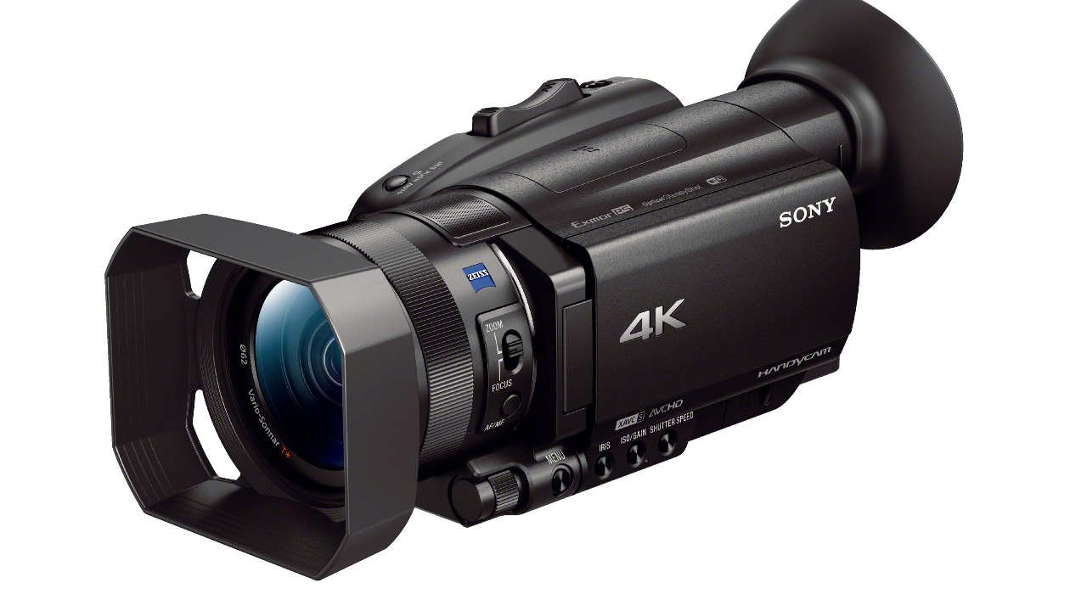
Slow-mo Guide for the Sony NX80 Camcorder

Slide 2
Equipment needed
Sony NX80 Camcorder (with it there should be two compatible batteries, a tripod mounting base, a remote, and battery charger)
Tripod (will need to be compatible with the NX80's tripod mount, they can be found in the electronics center in office 167A)
SD or MicroSD card (SD cards must have a class 10 or U1 speed rating at a minimum)

Slide 3
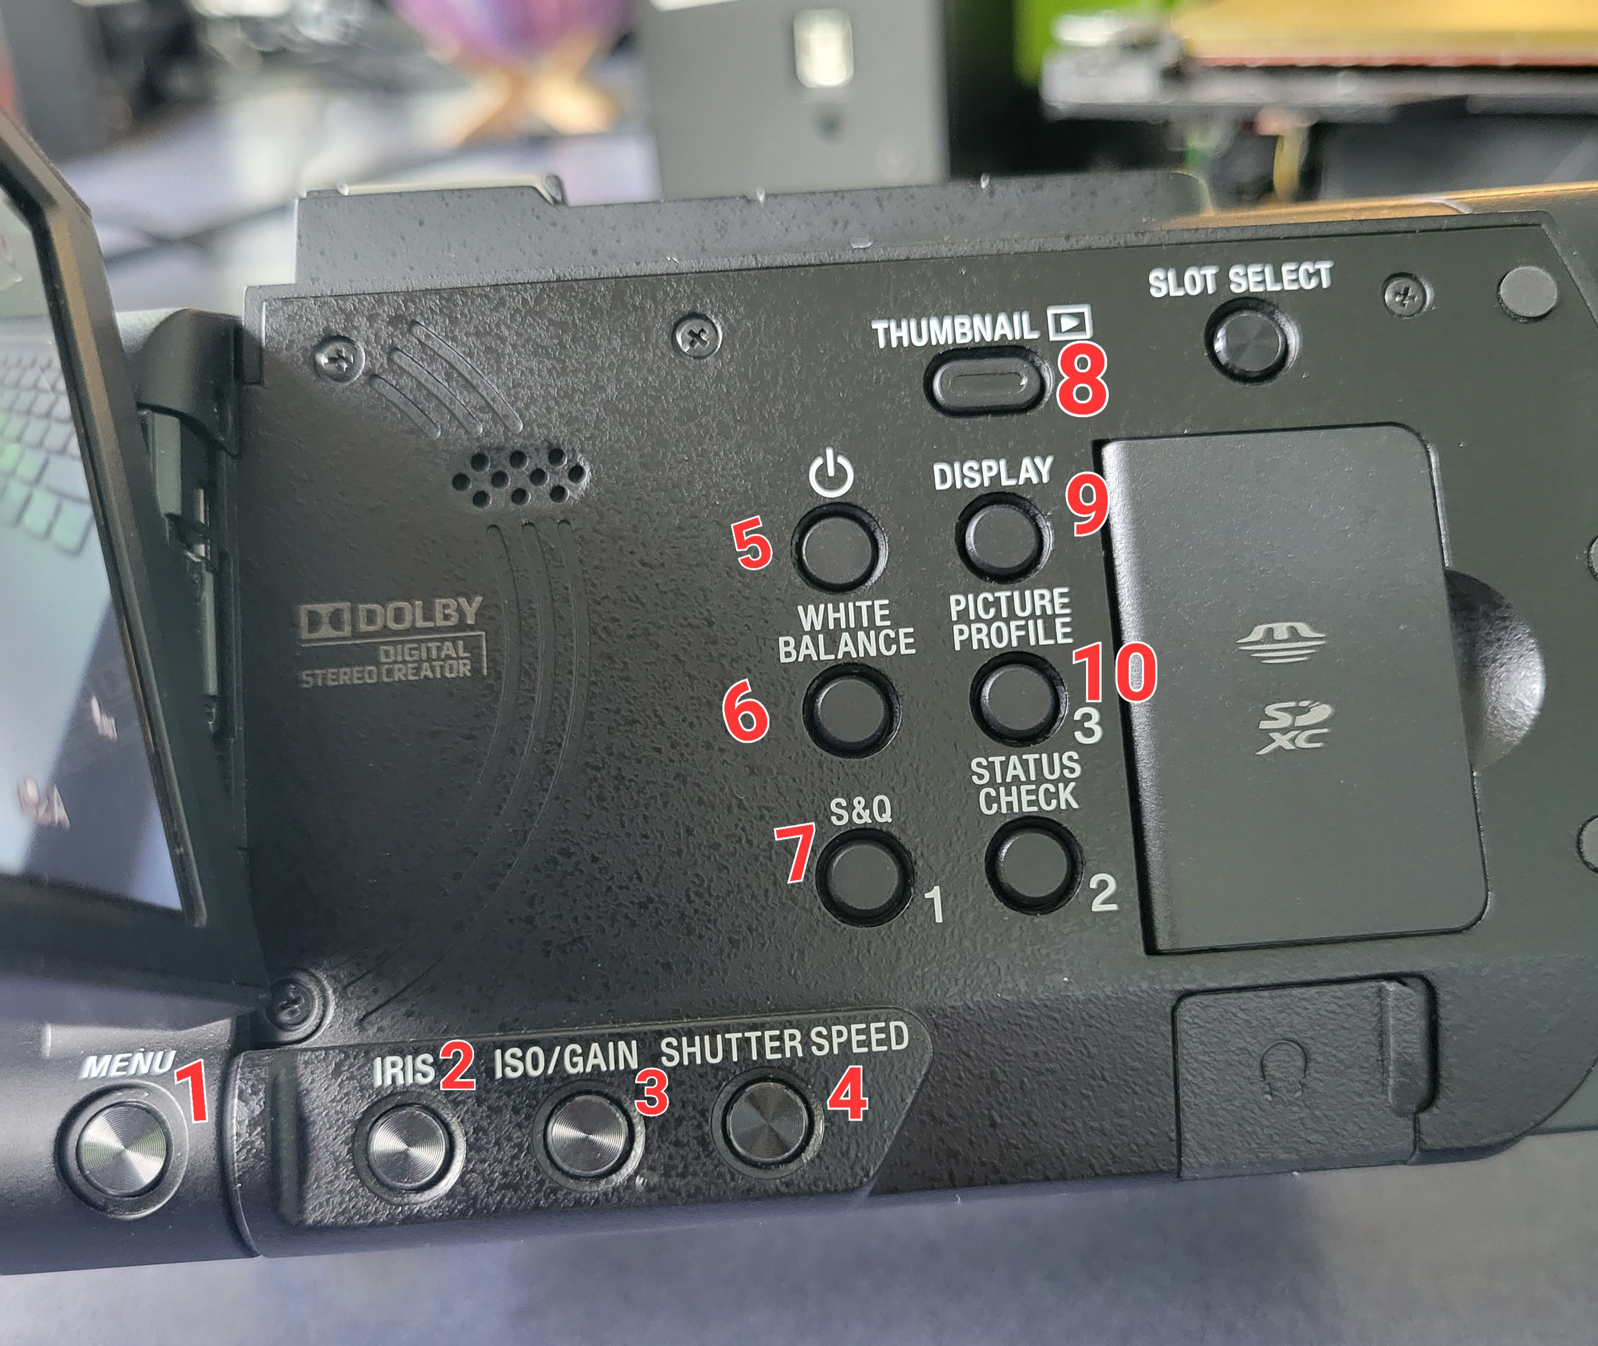
Button Layout and Functions
Menu: Press to access the camera menu
Iris: The iris is an adjustable opening (aperture), which controls the amount of light coming through the lens.
ISO/Gain: ISO is your camera's sensitivity to light as it pertains to either film or a digital sensor. A lower ISO value means less sensitivity to light, while a higher ISO means more sensitivity.
Shutter Speed: the speed at which the shutter of the camera closes. A fast shutter speed creates a shorter exposure — the amount of light the camera takes in — and a slow shutter speed gives the photographer a longer exposure.
Power: Press once to turn onor put in sleep mode/Press and hold to turn off.

Slide 4
Button Layout and Functions
6. White Balance: used to adjust colors to match the color of the light source so that white objects appear white.
7. S & Q: Quickly switch to slow motion mode.
8. Thumbnail: Access memory cards media.
9. Display: Used to change the number of things in the HUD on the camcorder.
10. Picture Profile: switches between different 'Profiles'.

Slide 5
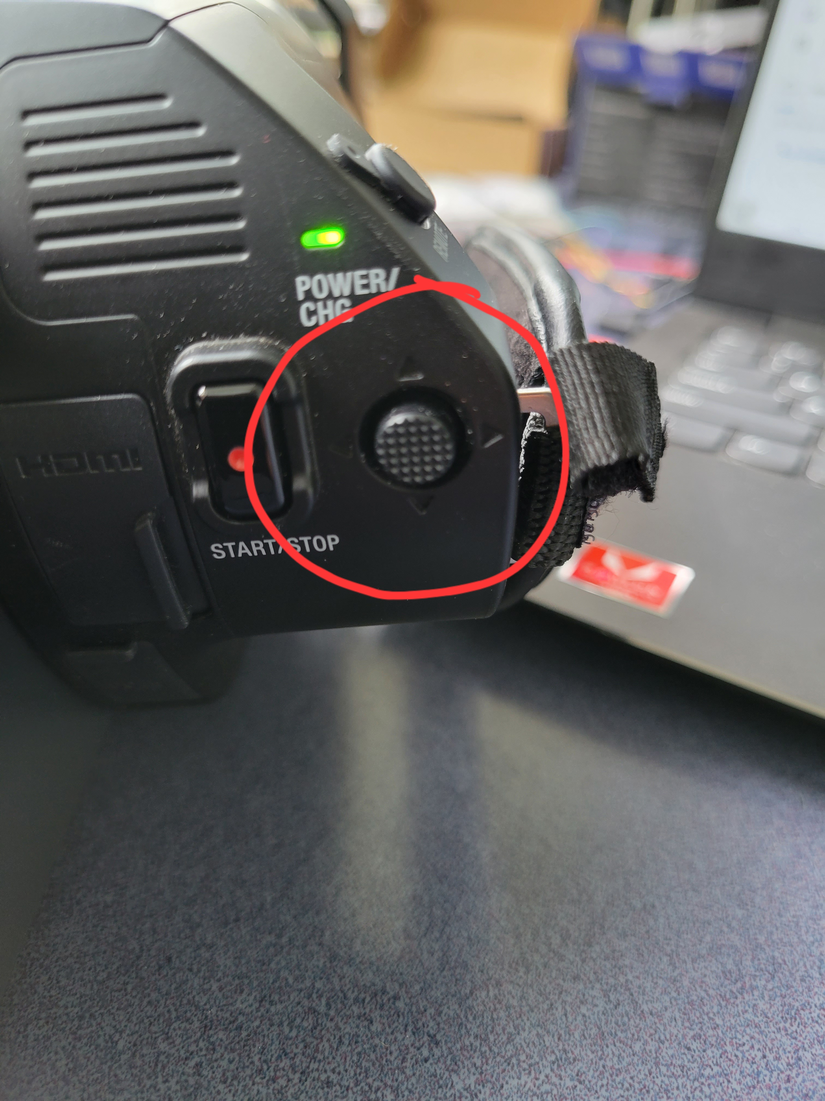
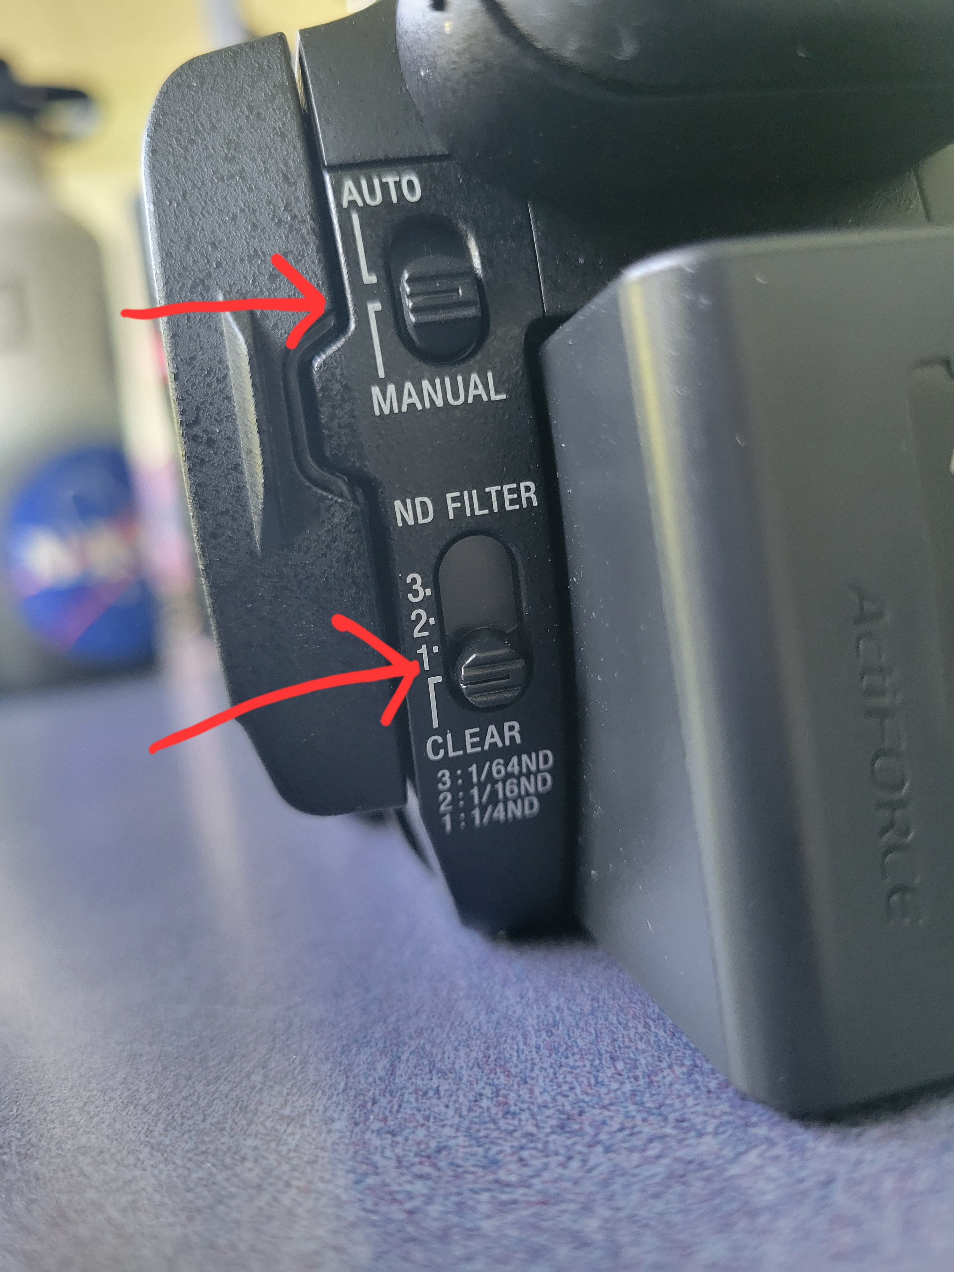
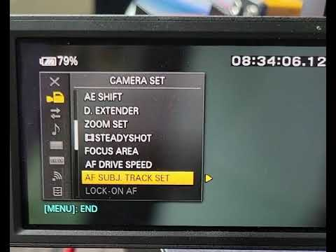
Finding the Slow-mo Settings
Use 5D button to navigate and make selections
*Manual/Auto shooting found here along with ND filter selection
Then navigate to the slow-mo settings by pressing MENU ---> CAMERA SET ---> SLOW & QUICK ---> SUPER SLOW MOTION. (play video to see an example)
*Camera must be in Manual mode to record in slow motion video

Slide 6
Frame Rates, Resolution, and Triggers
How to choose the correct frame rate, resolution, and recording trigger to create your ideal slow-motion video.

Slide 7
Finding the Slow-mo Camera Settings
Use 5D button to navigate and make selections
Then navigate to the slow-mo settings by pressing MENU ---> CAMERA SET ---> SLOW & QUICK ---> SUPER SLOW MOTION. (play video to see an example)
Record video of slow mo settings location and insert it here

Slide 8
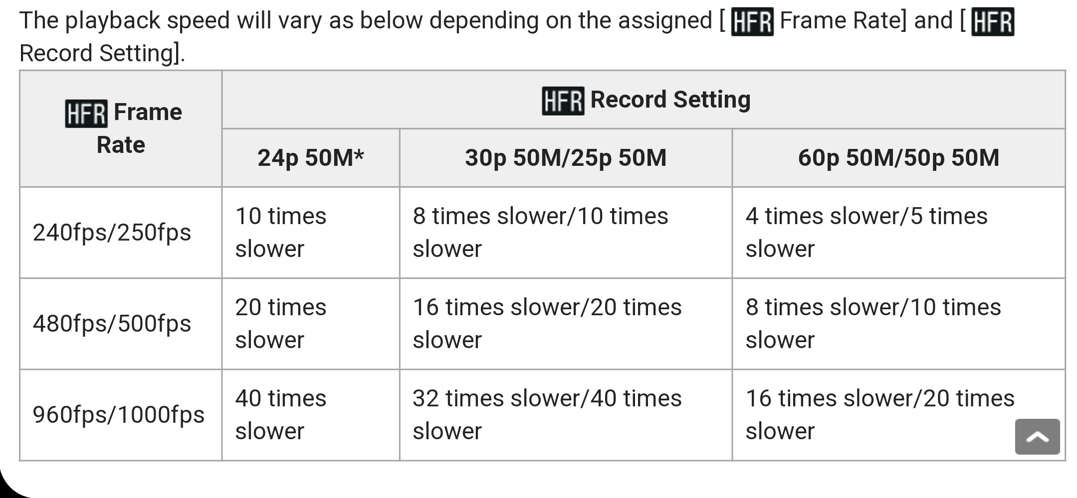
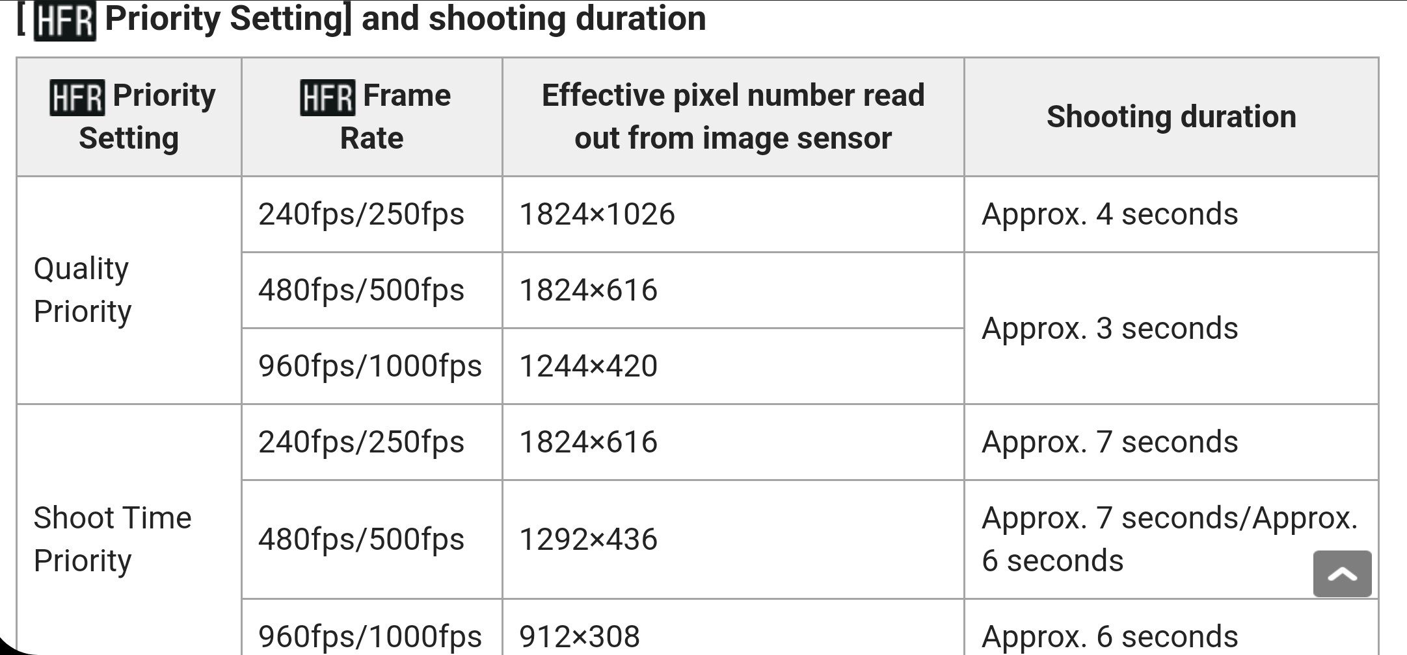
Choosing the correct Frame Rate & Resolution
Guide to the rate of slowdowns depending on the FPS and Recording setting
Video quality vs time priority guide showing the relation between FPS, resolution, and total recorded time*
*Total time recorded may differ as this is generalized between numerous Sony camcorders

Slide 9
Choosing the correct Frame Rate & Resolution (Cont.)
Guide to the rate of slowdowns depending on the FPS and Recording setting
Video quality vs time priority guide showing the relation between FPS, resolution, and total recorded time*
*Total time recorded may differ as this is generalized between numerous Sony camcorders

Slide 10
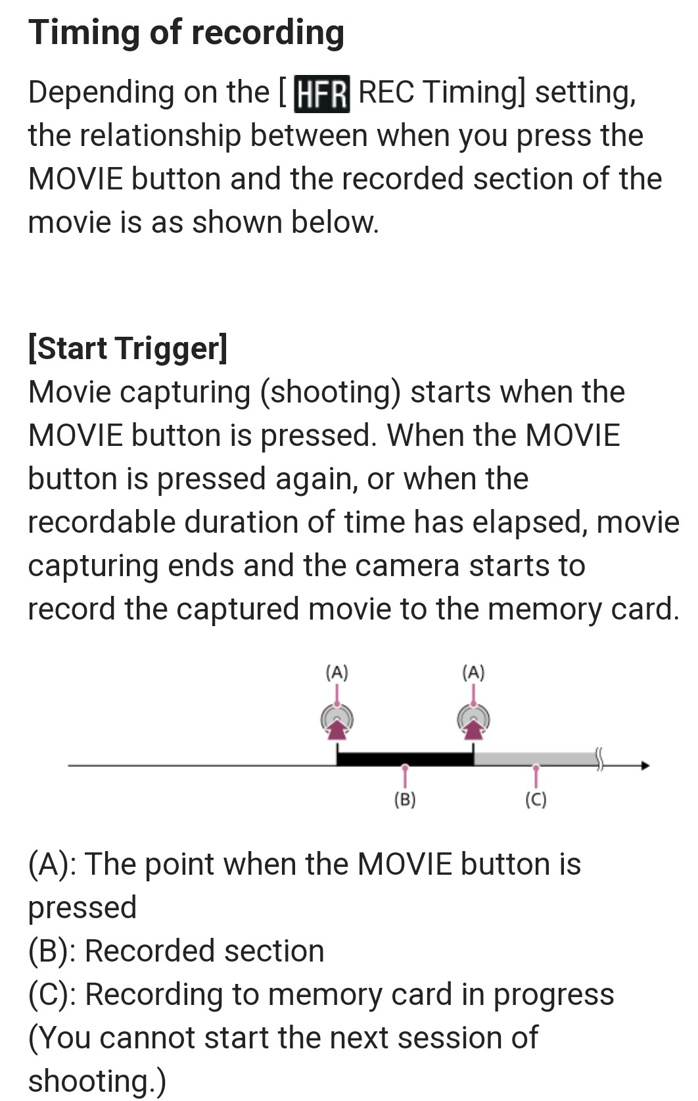
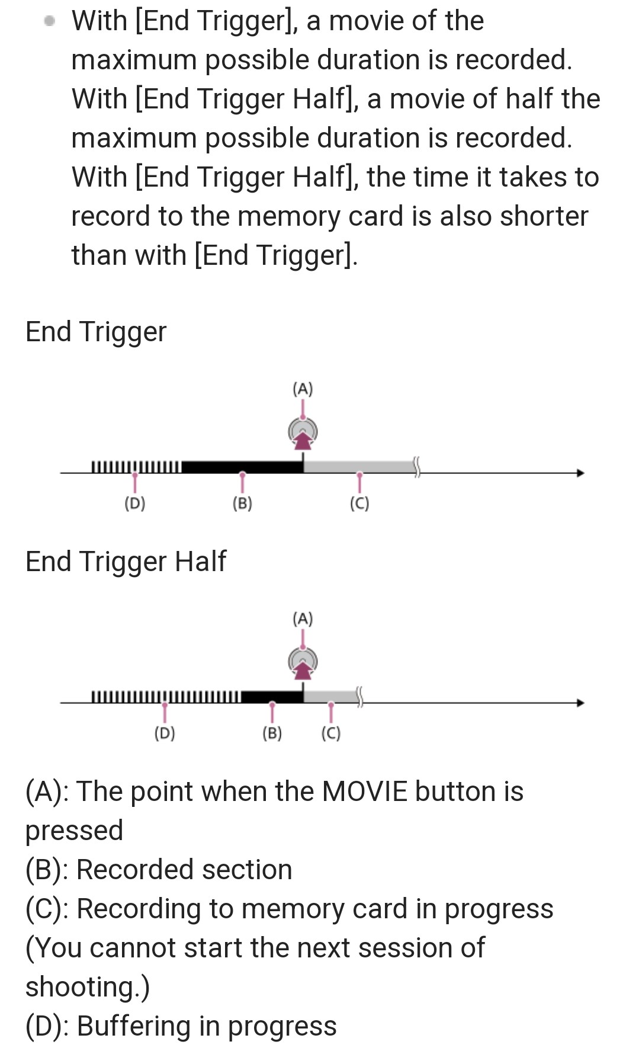
Choosing the Correct Trigger Mode
Start Trigger Guide
End Trigger & End Trigger Half Guide

Slide 11
Exposure Levels and focusing
Setting up the camera to have decent lighting and be in focus during shooting.

Slide 12
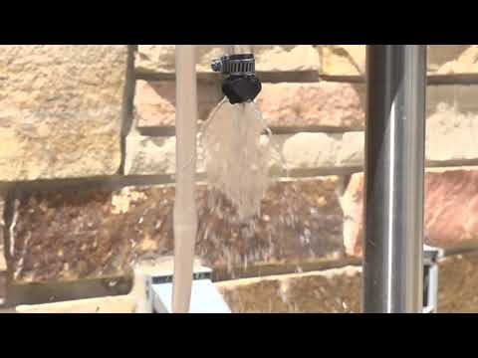
Exposure Levels Overview
Example of correct exposure settings
The reason we want to go over exposure levels is because the camera has to be in manual mode to shoot in slow-motion.
In photography and videography, exposure is the amount of light per unit area reaching the surface of an electronic image sensor, as determined by shutter speed, lens F-number, and scene luminance (a.k.a. white balance).
When you shoot a perfectly exposed video, you are capturing all the details in the highlights and the shadows. Allowing the subject to be clearly visible for analysis.
To obtain a video with proper exposure levels you will need to mess around with the Iris, ISO/Gain, Shutter Speed, and White balance settings until the subject is clearly in view.

Slide 13
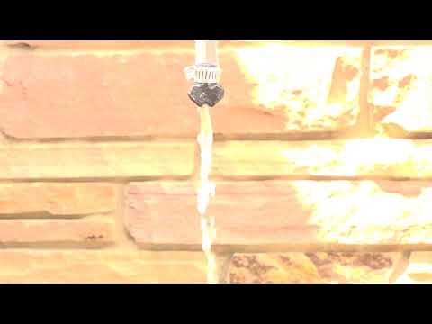
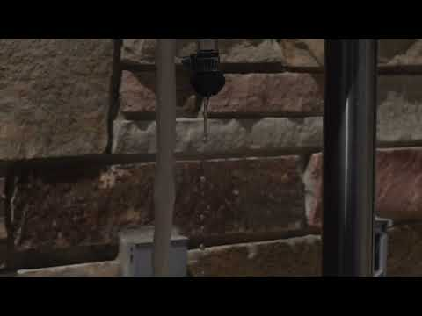
Over Exposed vs Under Exposed Shooting
Over Exposed (Too Bright)
Under Exposed (Too Dim)
Insert Fix Here
Insert Fix Here

Slide 14
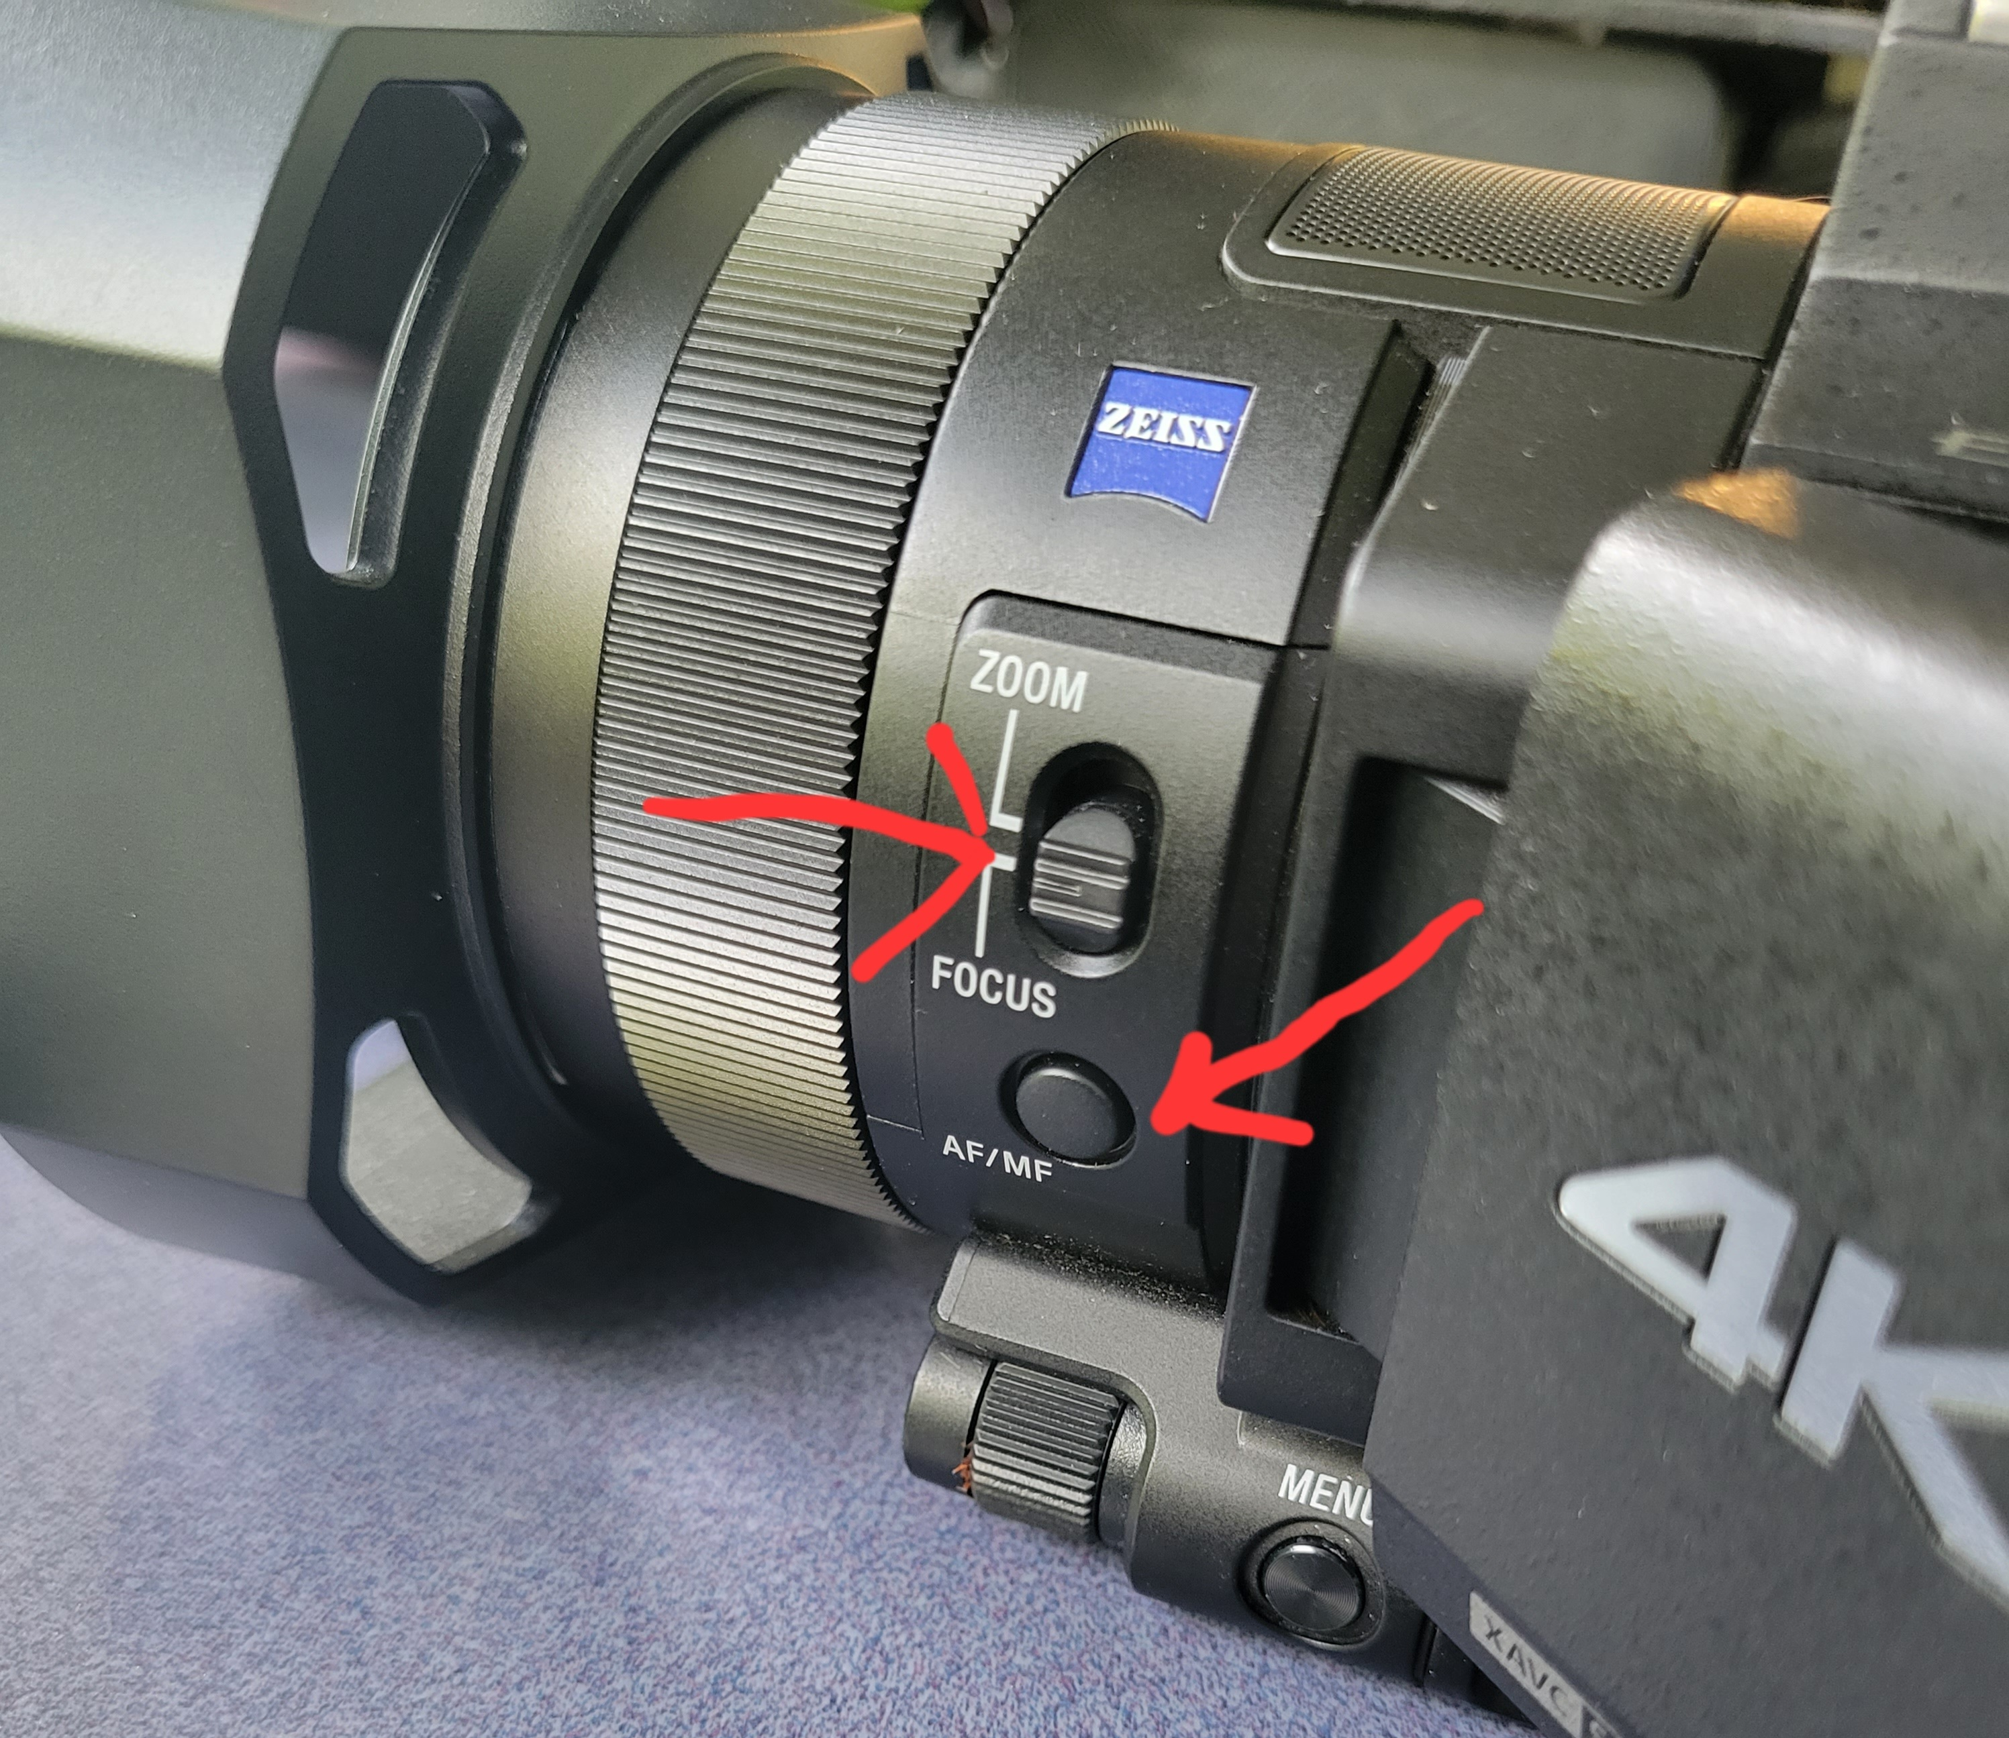
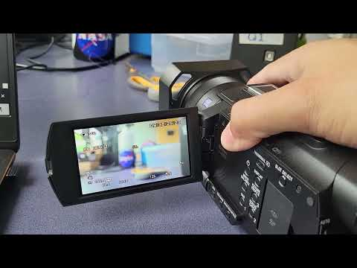
Focusing on the Subject
Zoom/Focus & Auto/Manual Focus Mode location
Once in manual focus, turn the zoom/focus wheel on the camera lense until your subject is in focus

Slide 15
Now you are ready to go!
Have Fun!

